Slide 1

Pathway Analyser
Programming for the Life Sciences
Yul van der Stap,
Maaike Trân & Inma Carrascosa
7th December 2018

Slide 2
Overview
Introduction
Methodology
Discussion
Conclusion

Slide 3
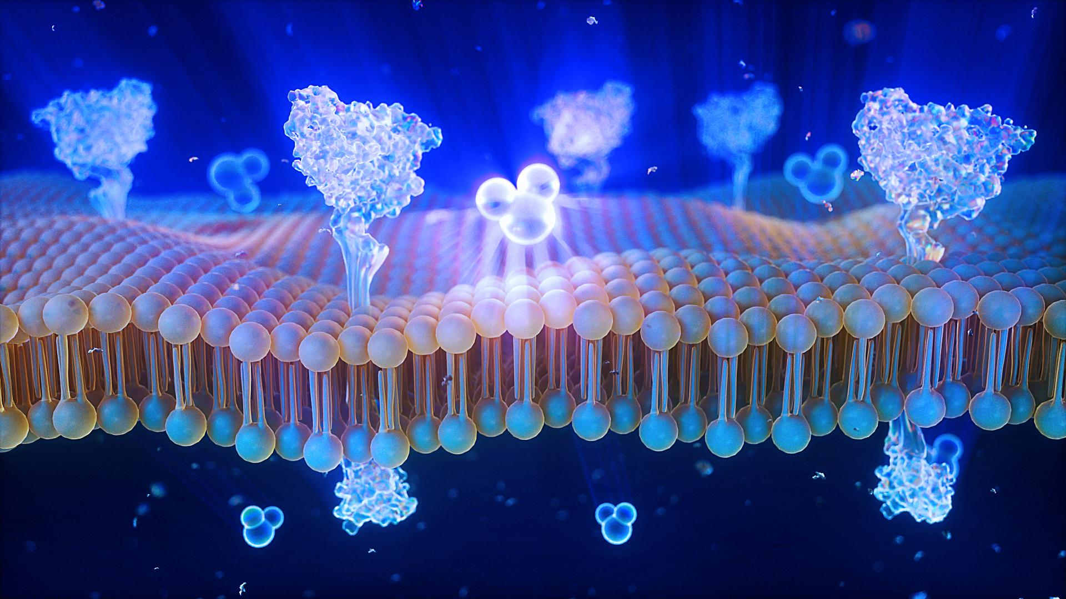
Importance of lipids
One of the four fundamental classes of biological compounds
Physiological importance, Energy Storage and Signalling
They contribute to numerous diseases and abnormalities
Watson, A. D. (2006, October). Lipidomics: a global approach to lipid analysis in biological systems. Journal of Lipid Research(47), 2101-2111.

Slide 4
Lipidomics
Genomics, proteomics and metaomics integrated approach for the understanding of lipids and their role in biological systems
Watson, A. D. (2006, October). Lipidomics: a global approach to lipid analysis in biological systems. Journal of Lipid Research(47), 2101-2111.

Slide 5
Lipid bio-synthesis pathways
Lipid-based diseases can not easily be understood without the visualization of lipid bio-synthesis pathways
Watson, A. D. (2006, October). Lipidomics: a global approach to lipid analysis in biological systems. Journal of Lipid Research(47), 2101-2111.

Slide 6
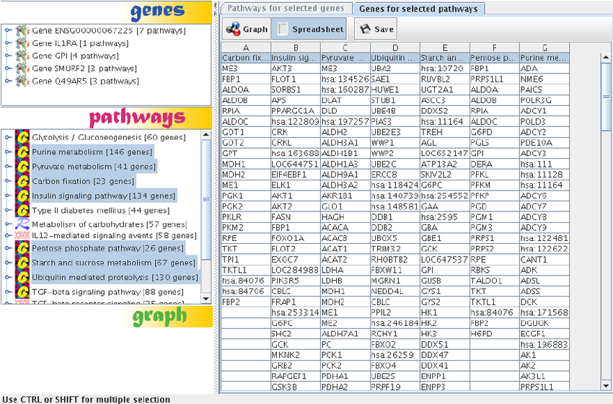
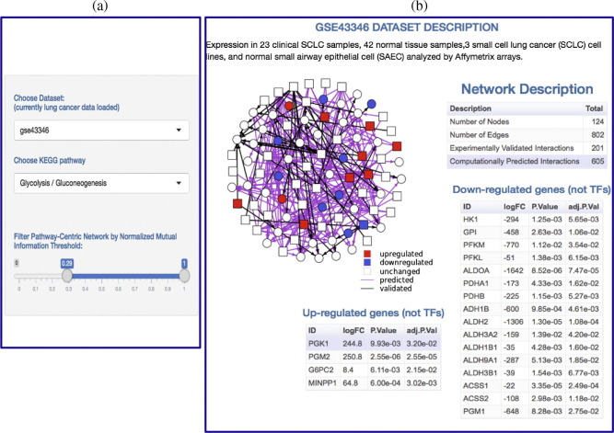
Pathway data visualization A key component of scientific research
Raw scientific data
Visualization
Enhances interpretation of scientific data
Difficult to interpret
Cirillo, E., Parnell, L. D., & Evelo, C. T. (2017). A Review of Pathway-Based Analysis Tools That Visualize Genetic Variants. Frontiers in genetics, 8, 174. doi:10.3389/fgene.2017.00174
Notes:
Data visualization enhances interpretation of scientific data
Pathway analysis is a useful method for data analysis

Slide 7
General Biological question
Given a lipid biosynthesis pathway, how can we obtain more information about its elements?

Slide 8
Biological question
Are the elements in the given pathway present in other pathways?

Slide 9
Biological question
If so, in which ones and in how many?

Slide 10
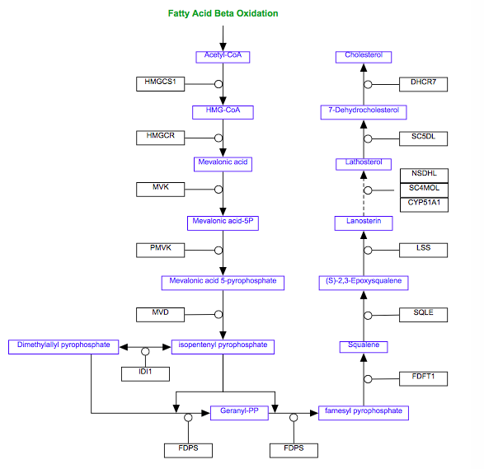
Cholesterol Biosynthesis
Given the cholesterol biosynthesis pathway, how can we obtain more information about its elements?
Are the elements in this pathway present in other pathways?
In how many?

Slide 11
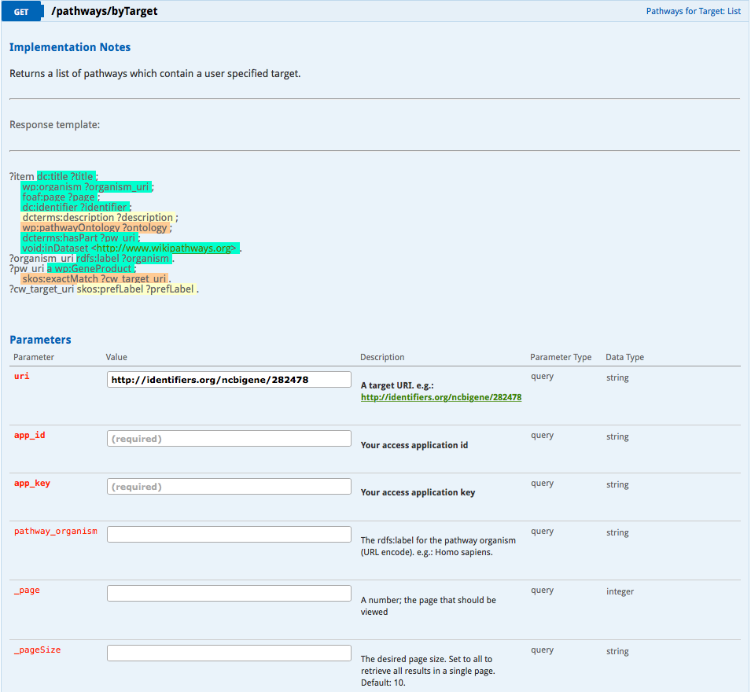
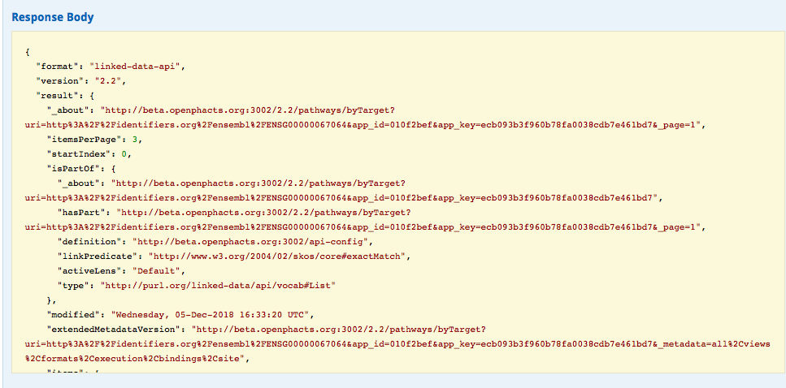
Manually answering question
Fill in all fields
Run call
Read through results

Slide 12


Slide 13


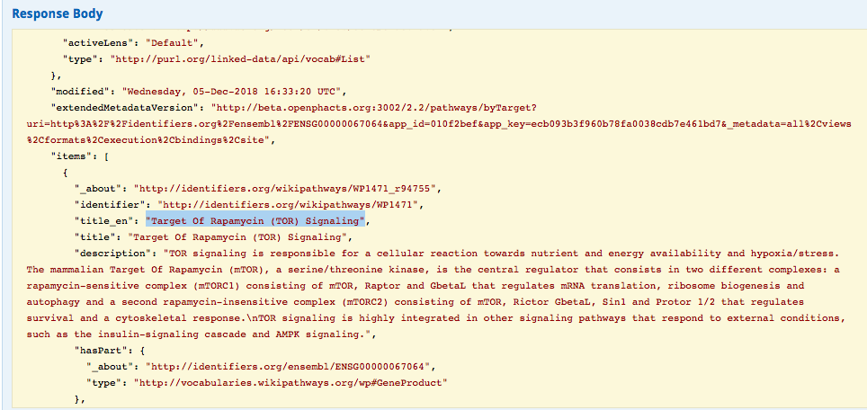
Finally! That’s just one of the 10 targets I was looking for…

Slide 14
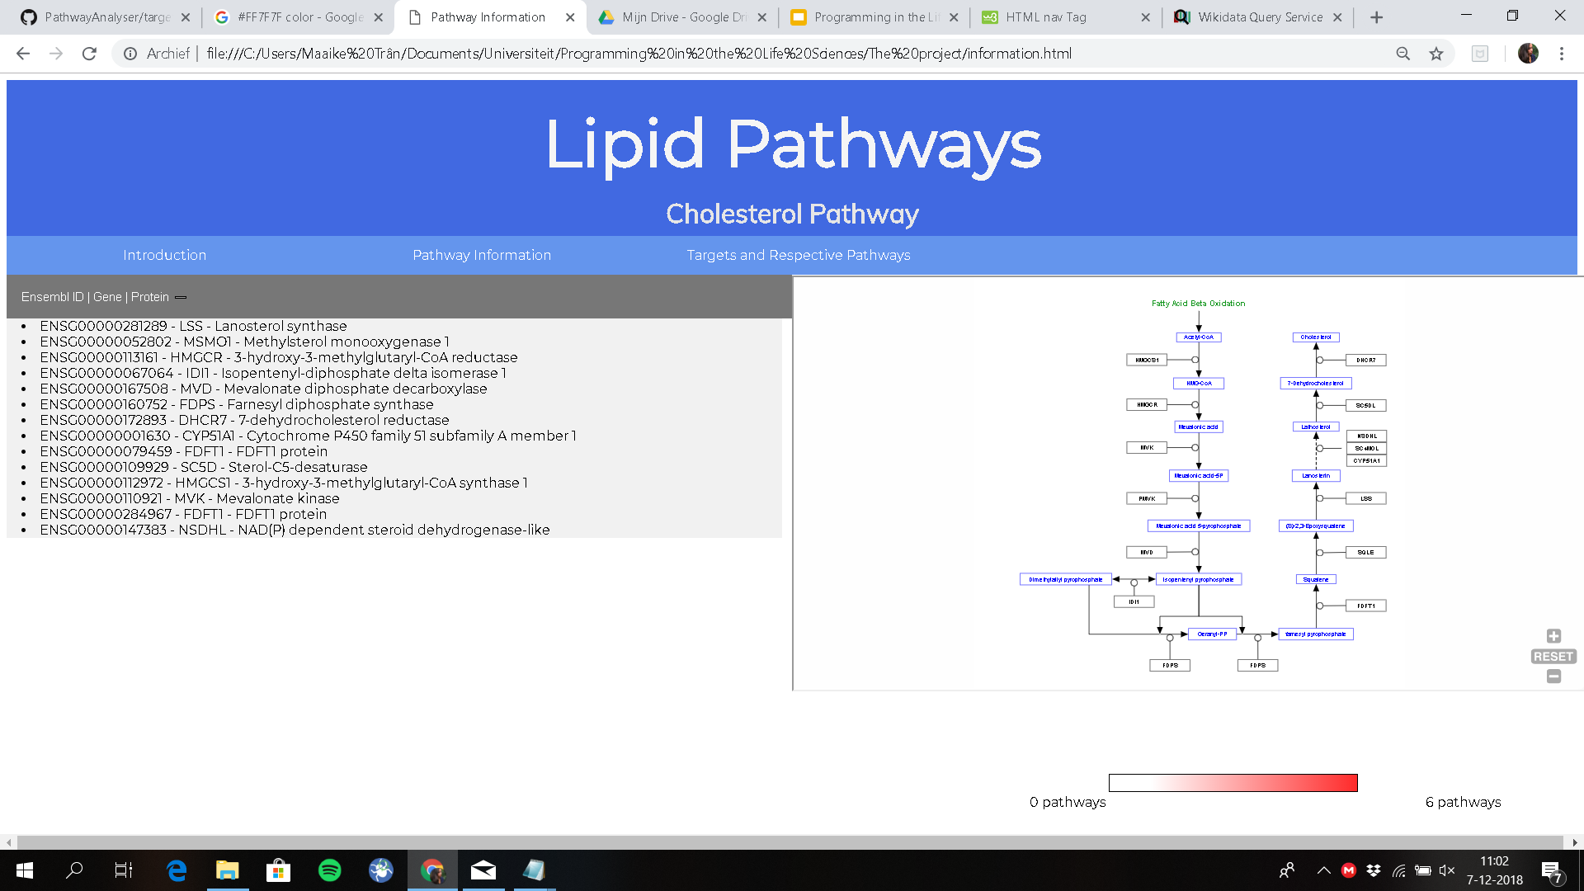
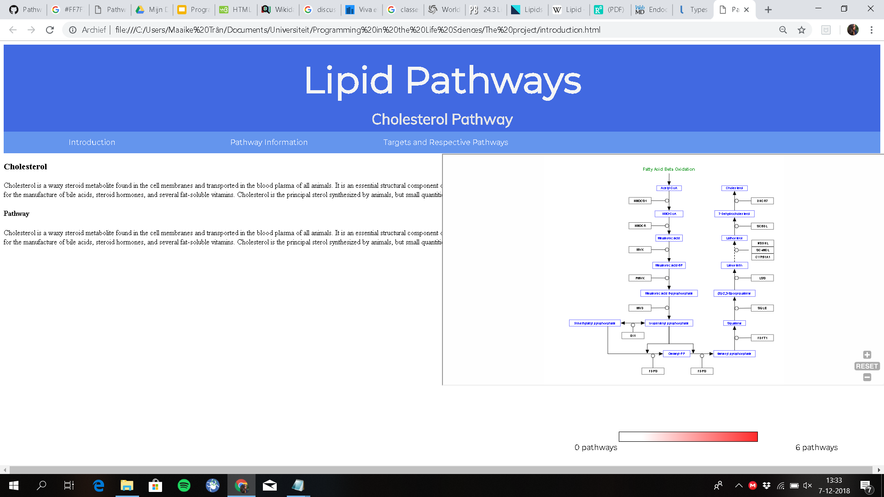
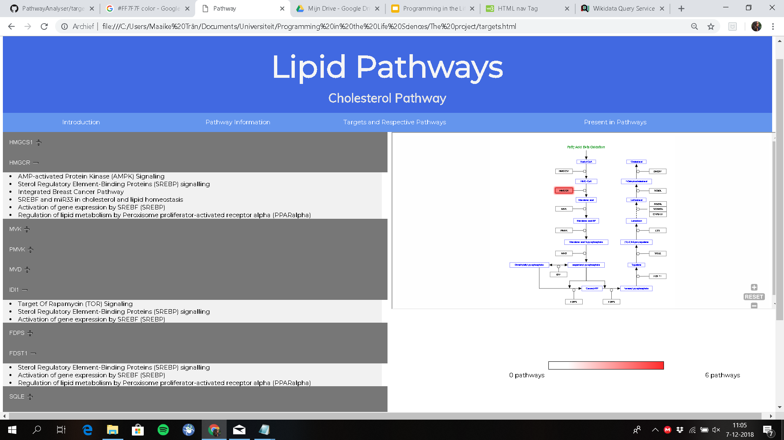
Solution: PathwayAnalyser

Slide 15
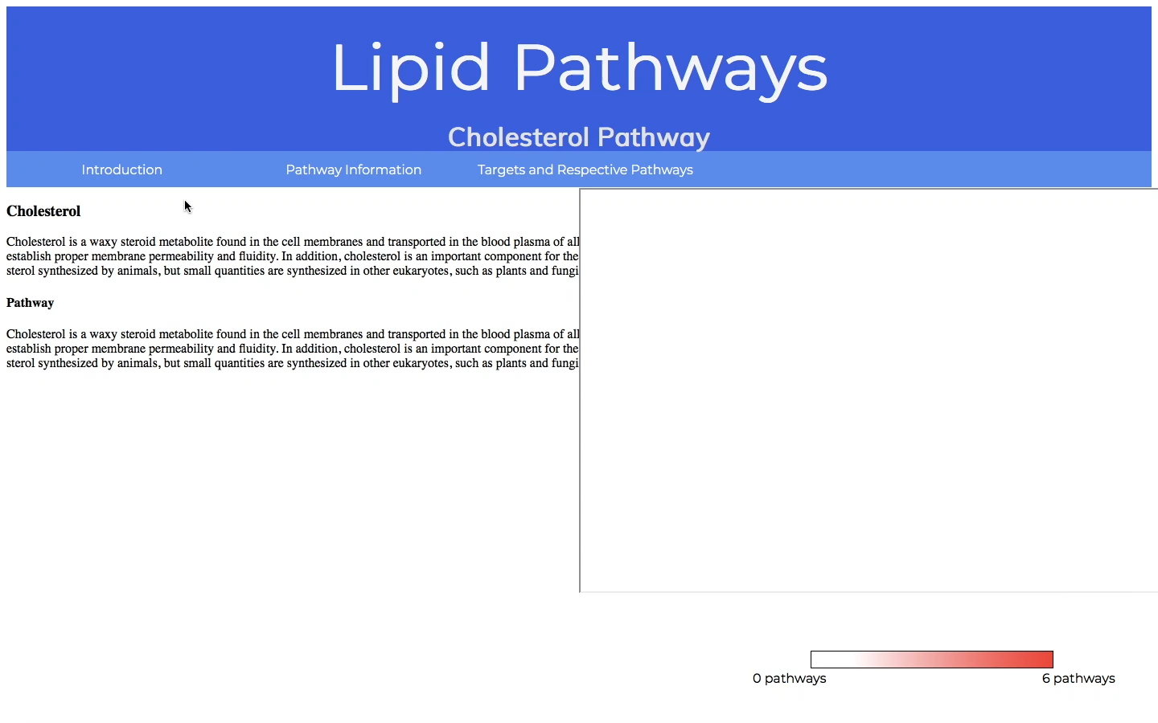
Solution: PathwayAnalyser

Slide 16

Methods

Slide 17
Libraries
<script src="https://cdn.rawgit.com/maxlath/wikidata-sdk/master/dist/wikidata-sdk.js"></script>
Wikidata query
<script type="text/javascript" src="https://egonw.github.io/pils/lib/d3.v3.min.js"></script>
D3
<script type="text/javascript" src="https://egonw.github.io/pils/src/combined.js"></script>
Pathway search by target
Count Pathway by target

Slide 18
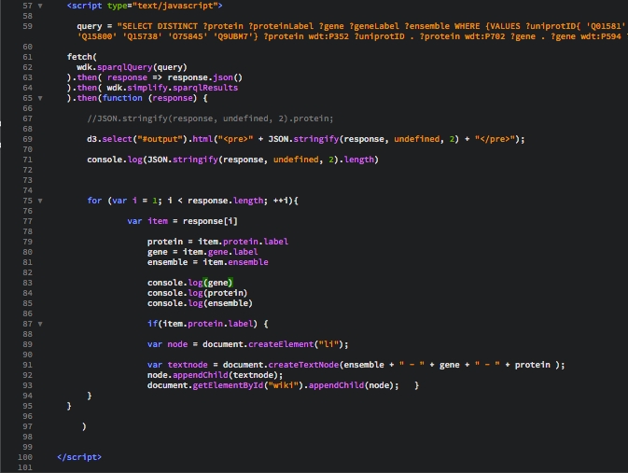
Pathway Information
Wikidata query
Reading jSON file from query call and creating a list with the desired items

Slide 19
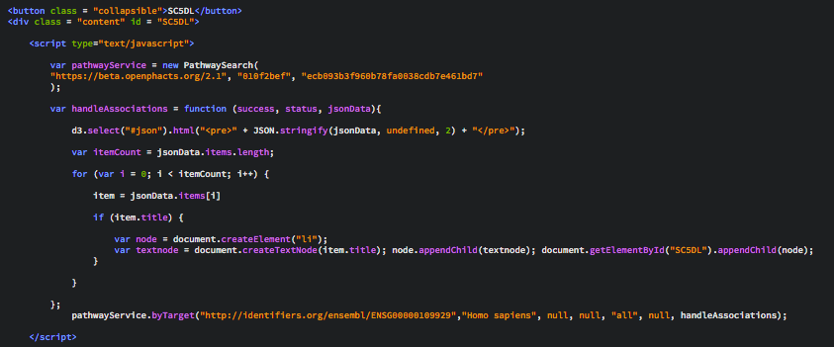
Targets and Respective Pathways
Gene of interest
Processing jSON file
Open Phacts API call

Slide 20

Targets and Respective Pathways
Repeat for every gene of interest

Slide 21
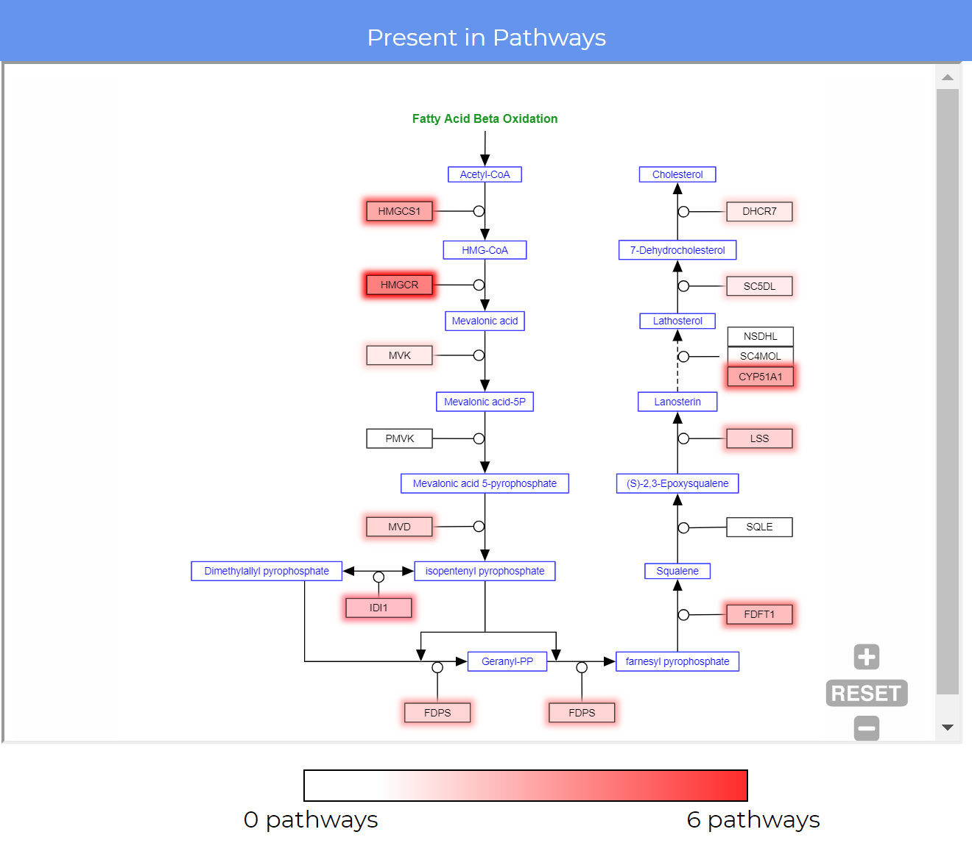
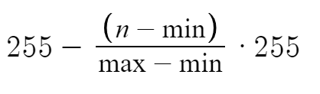
Visualising the Counts
calculating corresponding colour code
Convert to hexadecimal
gene id
color code
Notes:
NEW SCREENSHOT

Slide 22
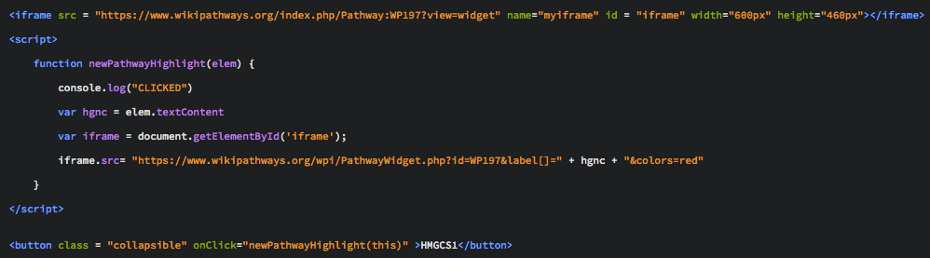
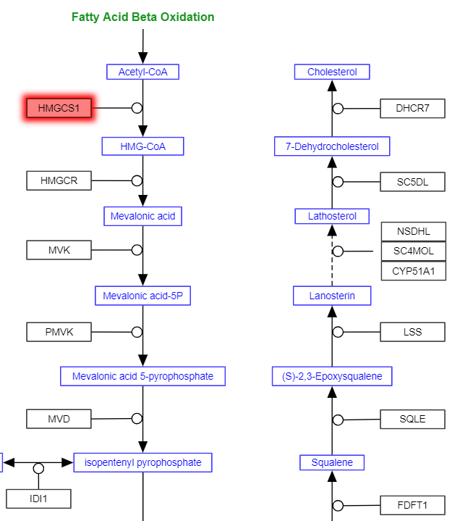
Highlighting selected Gene
Get protein id
New iframe
directory
Activate function

Slide 24

Discussion

Slide 25
Discussion & Conclusion
Achievements | Limitations
Answers biological question | Manually visualising the Counts
Two web service calls from two sources | Protein id extraction from iframe
Interactive for the user | Count Pathway Array
Visualising data | Max and min of Array
Simple and concise

Slide 26
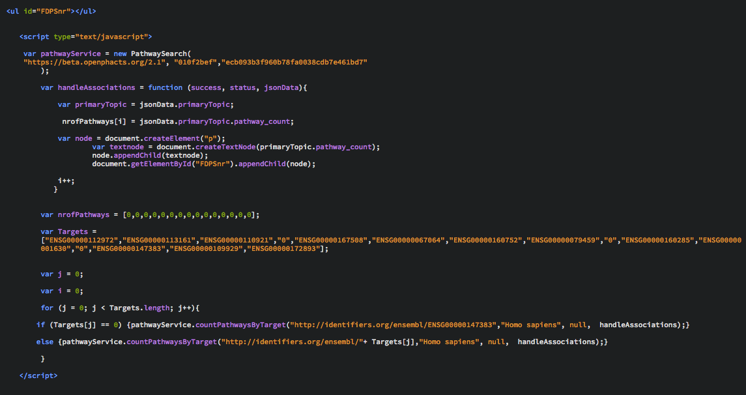
The next step
Processing jSON file
Empty array
Array of compounds
Loop which makes the Open Phacts API call

Slide 27
Future Possibilities
Fully automated
More implementations
Pathway analyser for any pathway

Slide 28
Any questions?

